Slide 1
ACE Cloud Security
ACE Solutions Architecture Team
Notes:
The ACE-Security course and all the presentations are created or organized by Shahzad Ali Please reach out to provide feedback so we can improve it.
This course is built by Shahzad Ali with the help from Joe and Rizwan from ACE Team.
For comments, please reach out to shahzad@aviatrix.com for comments or improvements.

Slide 2


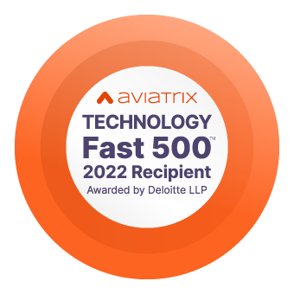



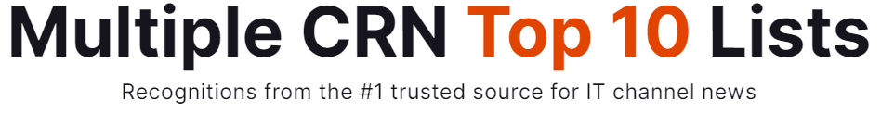

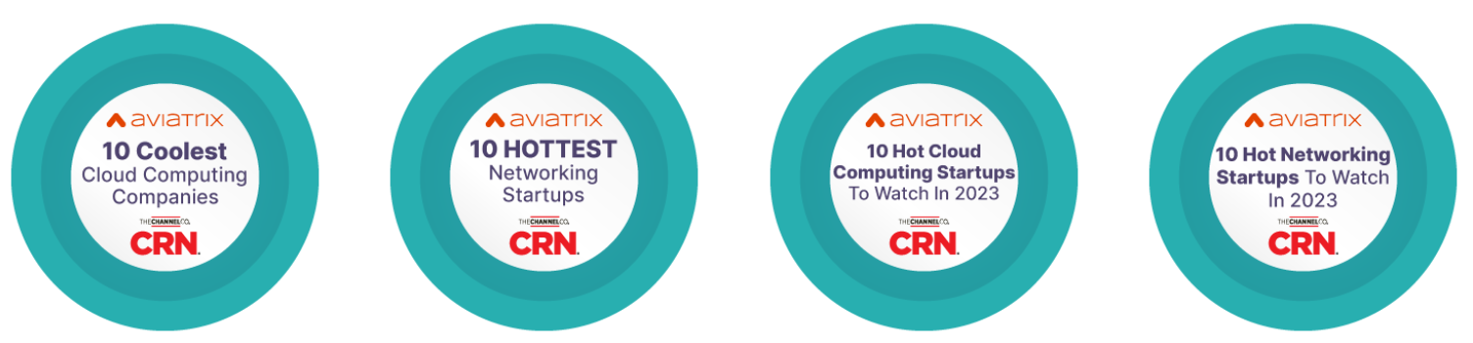
Aviatrix Awards and Recognitions
Top 25 Enterprise Technology
Startups Powering the Economy
Best IT Company of the Year for IT Cloud
Ranked No. 711
Ranked No. 146
Hot Company of the Year for IT Cloud

Slide 3










































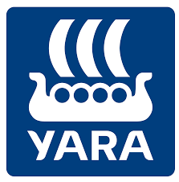



Aviatrix is Trusted by 500+ of the World’s Most Innovative Companies
Notes:
Customer names are references shared under NDA.

Slide 4




Aviatrix Secure Cloud Networking | Distributed Security and Operations
Embedded Security and Operations – The data plane sees every packet
Aviatrix
Controller
Aviatrix
CoPilot
Apps
VPC
VPC
VNET
VNET
VNET
VNC
VNC
Cloud Core/ Backbone
Access/Edge
Data
Center
Equinix
Manufacturing
Retail / Branch
Mobile and IoT

Slide 5

Course Overview and Learning Objectives
Overview:
Business-critical apps need advanced security controls with resiliency
Customers need “cloud-friendly” and "modernized” security solutions.
Overview of cloud security with a simple and repeatable approach
Augment CSP features with consistent security designs
Learning Objectives:
Design a Resilient Zero Trust Network Architecture (ZTNA)
https://www.nist.gov/publications/zero-trust-architecture
Learn the advantages of using a distributed security model over a centralized model
Learn the cost optimization tips and tricks while improving security.
Best practice, repeatable security design for single, multiple, and hybrid clouds.
Notes:
Old Course Objective
Build Zero Trust Network Architecture (ZTNA)
https://www.nist.gov/publications/zero-trust-architecture
Overview of cloud-native security options SG/NSG/ACL/NACL/WAF/etc.
Learn the advantages of using a distributed security model over a centralized model
Case Study → Design Security Exercise
Learn how you would use network security against threats such as Log4J
Cost-saving techniques while improving security
Target Audience
Networking and Security Engineers/Architects
Common security design patterns from a single and multicloud networking perspective.
This course is built by Shahzad Ali with the help from Joe and Rizwan from ACE Team.
For comments, please reach out to shahzad@aviatrix.com for comments or improvements.

Slide 6
Good to Know
Focus is on cloud security topics.
Fast paced and some overlap with ACE-Pro content
Use Aviatrix Sandbox Starter Tool to try. When done, destroy.
Access to read-only demo lab during the course
Aviatrix Sandbox Starter Tool (SST) https://t.ly/Azm8N
Notes:
The self-paced course at https://aviatrix.com/ace
Aviatrix Community page: https://community.aviatrix.com
Aviatrix YouTube page: https://www.youtube.com/c/AviatrixSystems
This course is built by Shahzad Ali with the help from Joe and Rizwan from ACE Team.
For comments, please reach out to shahzad@aviatrix.com for comments or improvements.

Slide 7
Aviatrix ACE Security Course Agenda
Topics | Approx. Duration (Minutes)
Introduction | 10
Zero Trust Architecture (ZTA or ZTNA) | 15
CSP Security Services | 15
Smart Groups | 15
Break | 10
Distributed Cloud Firewall | 30
Securing Internet Egress Traffic | 15
Network Segmentation | 15
Break | 10
Micro Segmentation | 20
ThreatIQ and Geoblocking | 15
High Performance Encryption | 15
Security Operations and Visibility - Demo | 30
Break | 10
Netflow, Alerts, and Reports – Demo | 30
RBAC and User VPN | 15
Self-Service LAB and Quiz | 30
Total Duration | 300 min (5 hours)
Meet the Presenters
Notes:
Unhide in instructor-led
This course is built by Shahzad Ali with the help from Joe and Rizwan from ACE Team.
For comments, please reach out to shahzad@aviatrix.com for comments or improvements.

Slide 8





















Big Brands Betting Big on ACE

Slide 9
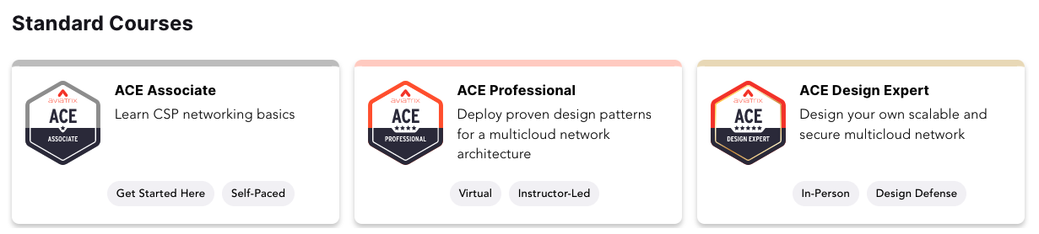
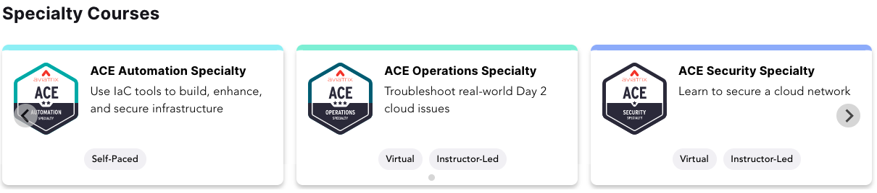
ACE Courses - https://aviatrix.com/ace/

Slide 10
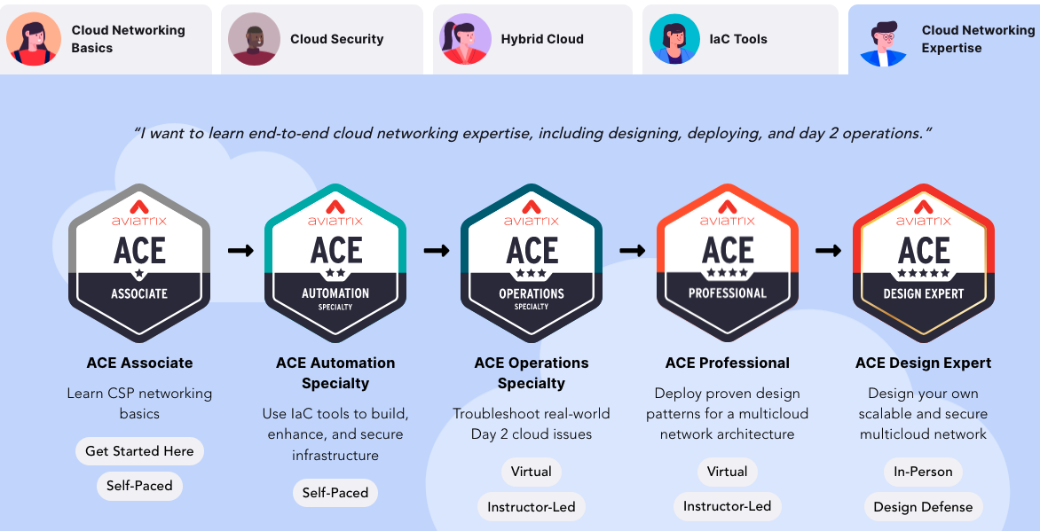
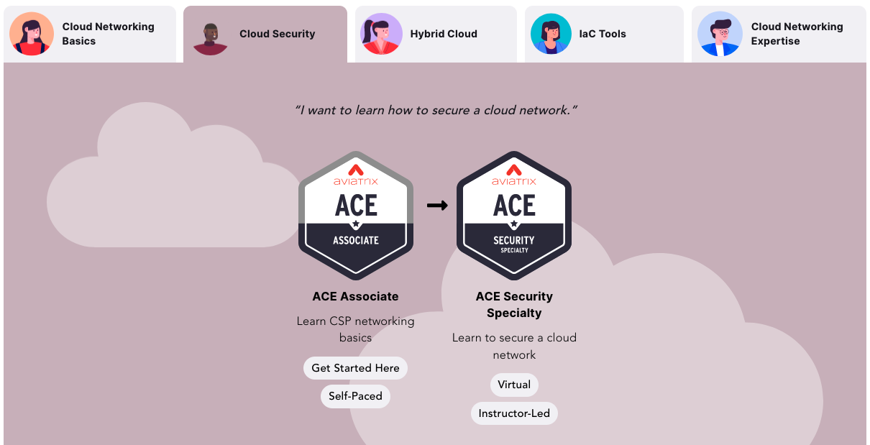
Learning Paths - https://aviatrix.com/ace/

Slide 11


Instructors
Rizwan Jamal
Senior Solutions Architect,
Aviatrix
Past: Equinix, Microsoft, Cisco
linkedin.com/in/rizwan-j-35429723/
Shahzad Ali
VP, Solutions Architecture
https://youtube.com/netJoints
https://Linkedin.com/in/ShahzadNET
USA
Canada

Slide 12
How to Get the ACE Security Certificate
ACE Associate is pre-req
Attend the training.
1
Pass the Quiz. 12questions. 66% passing score. Retake allowed. Based on the demo lab pod
2
Complete the Survey
3
Please do not share the Quiz and Survey links outside of this group

Slide 13
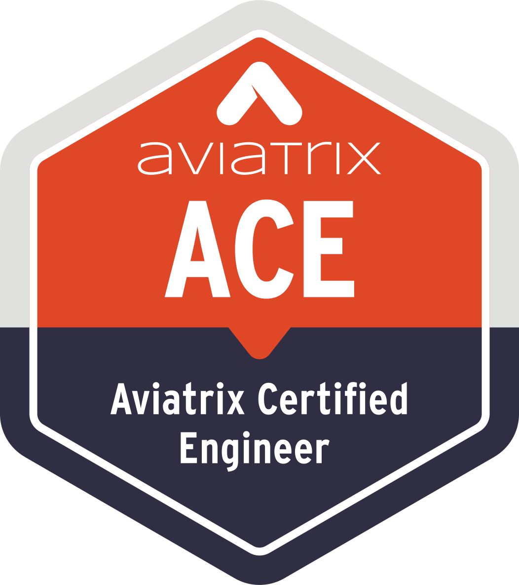

Aviatrix Certified Engineer (ACE)
COMMUNITY
https://aviatrix.com/ACE
https://community.aviatrix.com

Slide 14
Course Flow
101 Level What is it?
101 level How does it work?
101 Level Gaps/Limitations
101 Cost Implications

Slide 15
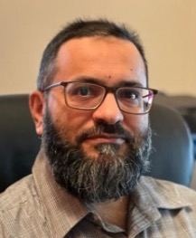
Instructors
Rizwan Jamal
Senior Solutions Architect,
Aviatrix
Past: Equinix, Microsoft, Cisco
linkedin.com/in/rizwan-j-35429723/
Abdul Rahim
Principal Solutions Architect, Aviatrix
Past: AWS, VMware, Cisco
CCIE RS , SP and DC
linkedin.com/in/arahimidris
Shahzad Ali
VP, Solutions Architecture
https://youtube.com/netJoints
https://Linkedin.com/in/ShahzadNET
USA
Canada
Australia

Slide 16
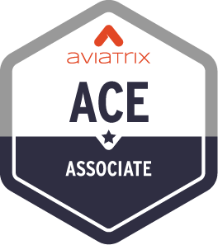
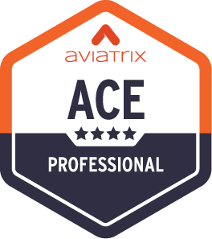

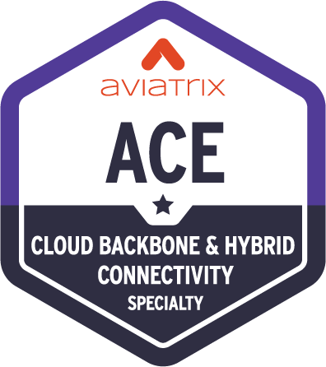
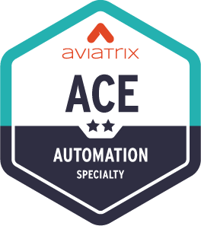
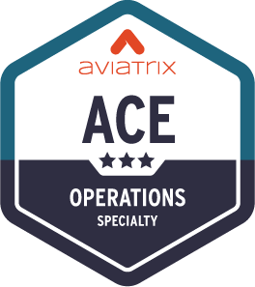
ACE Multicloud Networking Certification Program
Standard Learning Path
The Aviatrix Certified Engineer (ACE) Program is the industry’s first multicloud networking certification.
It's comprehensive training and specialized courses provide a deep understanding of building, operating, automating, scaling, and securing multi-cloud networks across AWS, Azure, Google Cloud, Oracle Cloud Infrastructure, and more.
The ACE Program ensures participants are equipped with best practices that span all major cloud providers and the Aviatrix Cloud Networking Platform.
6 Hours
Learn CSP networking basics and review Aviatrix features
3 Days
Deploy proven design patterns for a multicloud network architecture
Weeks
Design a highly available, scalable, and secure multicloud architecture
Optional Specialty Trainings
6 Hours
Learn Cloud Backbone and Hybrid Networking
4 Hours
Use IaC tools to build, enhance, and secure infrastructure
8 Hours
Troubleshoot real-world Day 2 cloud issues​

Slide 17
Industries and Roles Find Value in Aviatrix
Industries
Manufacturing
FinServ
Healthcare
Software
Business Services
Utilities
Retail
Government
Hospitality
Transportation
Roles / Titles
Network Engineering
Cloud Operations
Cloud Architecture
FinOps
DevOps
App Dev
Security and Cyber Roles

